Slide 1
Title VI
1964 Civil Rights Act
Local Highway Technical Assistance Council
October 2014

Slide 2
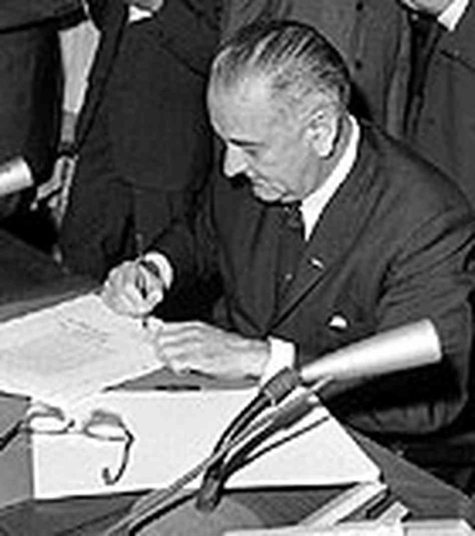
Civil Rights Act of 1964
  July 2, 1964, President Lyndon B. Johnson
  Signed the Act into law
Notes:
www.traviscountydemocrats.org

Slide 3
Title VI Requires:
  “No person in the United States shall, on the ground of race, color, or national origin, be excluded from participation in, be denied the benefits of, or be subjected to discrimination under any program or activity receiving Federal financial assistance.”
Notes:
sp.mdot.ms.gov
This has since been expanded to include disability

Slide 4

How Title VI Works
US Dept. Of Transportation
Federal
  Highway Funding
  Lands Highway Funding
FHWA
FTA
FAA
Idaho Transportation Department
State Transportation Agency (STA)
Mountain Home
Local Public Agency (LPA)
Notes:
Idaho Division Office
Monitor and provide direction to State Transportation Agency (STA)—Idaho Transportation Department
Ensure ITD monitors all Local Public Agencies (LPA)—City of Mountain Home, for compliance with Title VI non-discrimination requirements

Slide 5
Subrecipient Responsibilities
  Designate a Title VI Coordinator
  Develop and Sign a Title VI Assurance
    Report accurately on all items on checklist
  Ensure Title VI Provisions are in all Federally Funded Contracts (Create a Title VI Program)
  Establish a Method of Administration (Monitor Subrecipients and Contractors)
Notes:
mountain-home.airforcebase.us
Sign an Assurance
Contract obligating sub-recipient to comply with Title VI Statute.
Activities are conducted in a non-discriminatory manner.
Ensure Title VI Provisions are in federally funded contracts
Ensure Title VI provisions are in any other contracts extended to other subrecipients, including subcontractors.
Establish a Method of Administration
System of procedures policies and methods or
mechanisms to ensure non-discrimination in all
subrecipient activities and services regardless of
federal funding.

Slide 6
Title VI Program Components
  Documentation
  Limited English Proficiency Plan
    Who is LEP?
    What services do we provide?
    What resources?
  Environmental Justice Plan
    I.D. impacts to low income and minority populations
  ADA Transition Plan / Self Assessment
    City of Sandpoint – 5 year plan
    Service Animals / Braille
  HR Demographics
    How do we recruit? Targeting certain demographics?
  Complaints Processing
    Take complaints as seriously as possible
    Complaints should immediately be sent to Russ Rivera, ITD CCO
Notes:
Pre-award documentation
Title VI Policy and annual procedures
Nondiscrimination policy statement
Pre award assurances check list
Discrimination complaint procedures
Discrimination complaint Log
Limited English Proficiency Plan
Including four factor assessment
Deliverables showing implementation of LEP plan (copy of translated documents, communication / outreach plan, outreach material, etc.)
Environmental Justice Plan
Map of projects over 4-5 years with regards to impacted populations (Low income/ minority)
Summary of impacts from projects, outreach material and other deliverables showing the LPA’s efforts above and beyond typical outreach activities.
ADA Transition Plan / Self-Assessment
HR Demographics
Break-down of all full time employees with race / gender demographics
List of hiring opportunities and demographics of recently hired staff members
Recruitment plan showing additional actions to address underutilizations in underrepresented groups (women / minorities).
List of Complaints and Resolutions

Slide 7
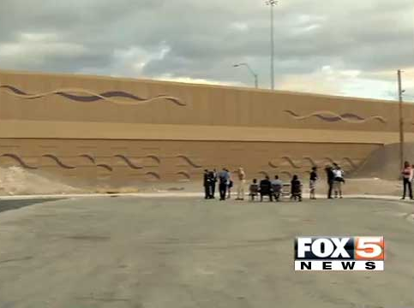
So, Why Should You Care?

Slide 8
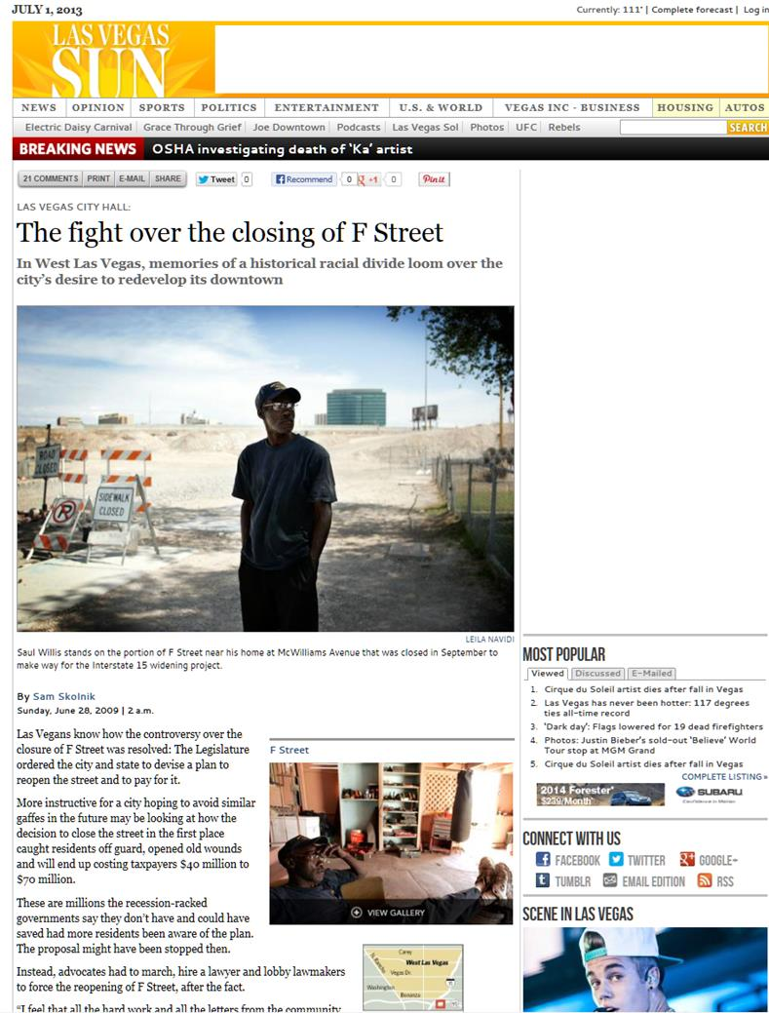
70 Million Reasons To Care

Slide 9
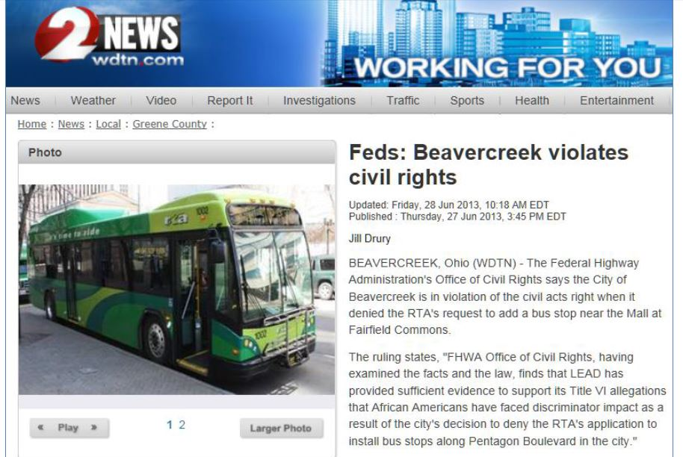
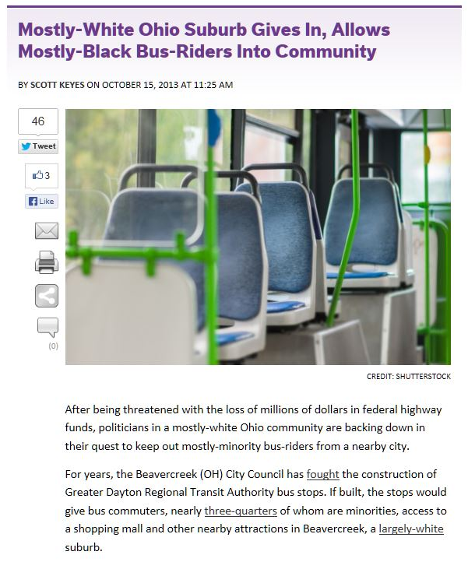
Ohio Town Risks $10 Million

Slide 10
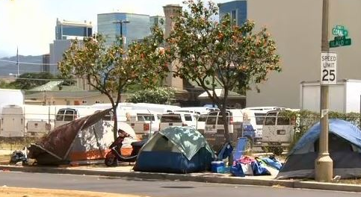

Homeless
Female veterans are the fastest growing segment of homeless in the U.S..
Cities have been successfully sued for unfair treatment of homeless populations.
ITD has developed best practices for working with homeless populations.

Slide 11

For more information contact
Russ Rivera
Contract Compliance Officer
(208) 334-8152
russ.rivera@itd.idaho.gov

